Slide 1
ELEMENTS, COMPOUNDS & MIXTURES
By Muhammad Ali
ہفتہ, 7, نومبر 2026
Notes:
M.ALI. SCIL, 2011-2012
CHEMISTRY RESOURCE 9C

Slide 2
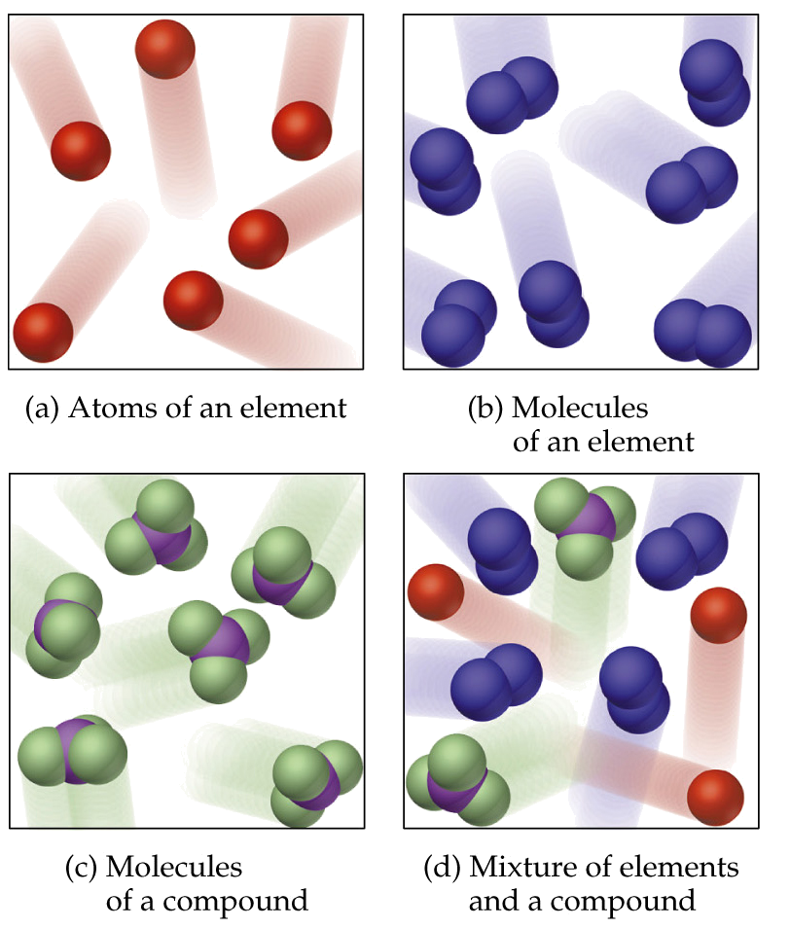
Classification of Matter
Matter is a substance that occupy space and has mass.
Matter can be classified into
i. Pure Matter
ii. Impure Matter
ہفتہ, 7, نومبر 2026

Slide 3
Pure Substances and Mixtures
If matter is not uniform throughout, then it is a heterogeneous mixture.
If matter is uniform throughout, it is homogeneous.
If homogeneous matter can be separated by physical means, then the matter is a mixture.
If homogeneous matter cannot be separated by physical means, then the matter is a pure substance.
If a pure substance can be decomposed into something else, then the substance is a compound.
If a pure substance cannot be decomposed into something else, then the substance is an element.
ہفتہ, 7, نومبر 2026

Slide 4
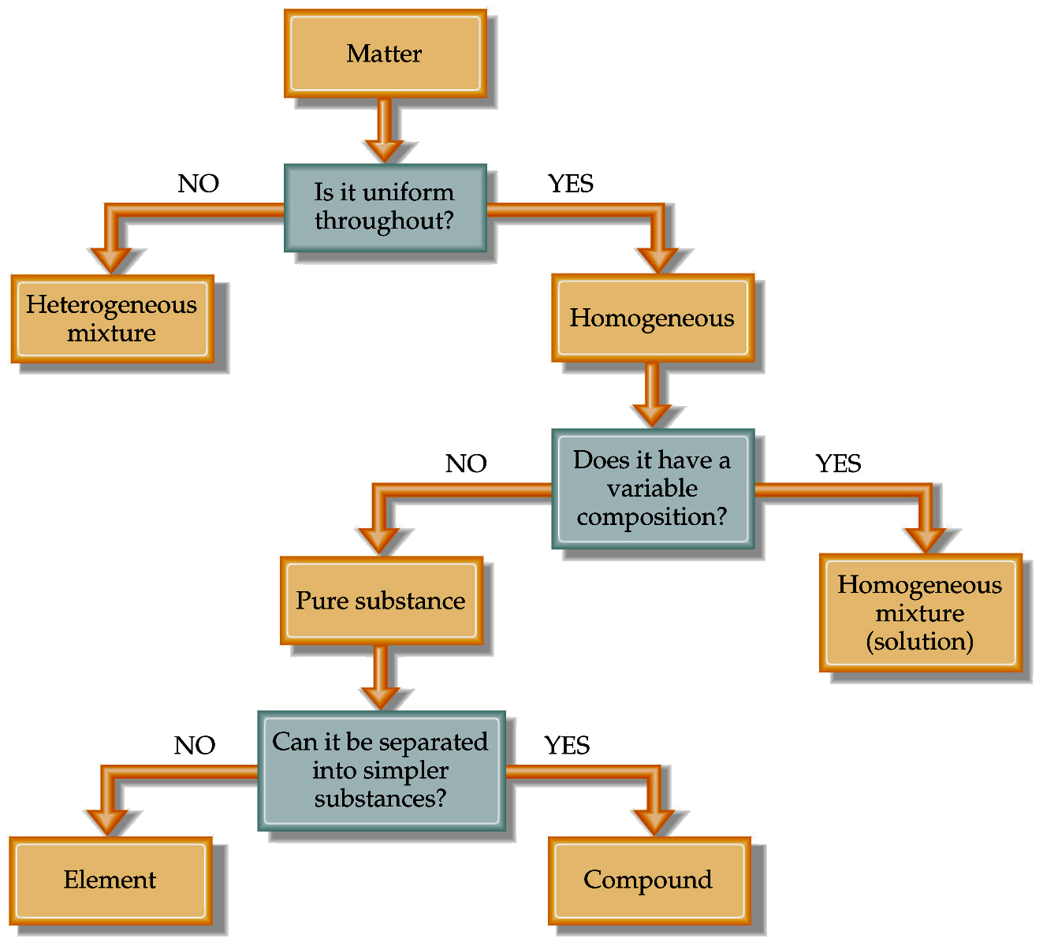
ہفتہ, 7, نومبر 2026

Slide 5
CHARACTERISTICS OF PURE & IMPURE SUBSTANCES
  A pure substance boils at a constant temperature i.e. it has a fix boiling point. An impure liquid could boil higher than the expected boiling point and over a range of temperature.
  A pure substance melts quite sharply at the melting point. An impure solid melts below its expected melting point and more slowly over a wider temperature range.
ہفتہ, 7, نومبر 2026

Slide 6
Elements
Element consist of unique type of atoms.
Element cannot be further broken into simple substance by any chemical or physical means.
There are 118 elements known.
Each element is given a unique chemical symbol (one or two letters).
Elements are building blocks of matter.
ہفتہ, 7, نومبر 2026

Slide 7
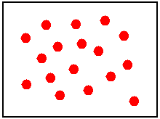
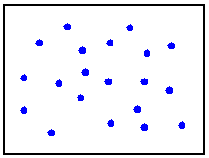
Elements
A sample of lead atoms (Pb). All atoms in the sample consist of lead, so the substance is homogeneous.
A sample of chlorine atoms (Cl). All atoms in the sample consist of chlorine, so the substance is homogeneous.
ہفتہ, 7, نومبر 2026

Slide 8
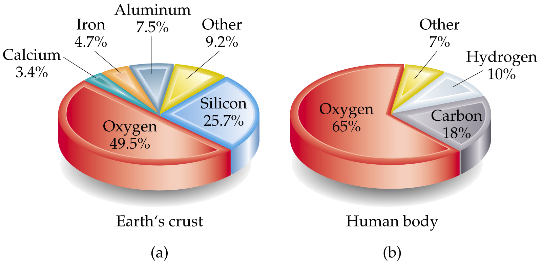
Elements
The earth’s crust consists of 5 main elements.
The human body consists mostly of 3 main elements.
ہفتہ, 7, نومبر 2026

Slide 9
Classification of Elements as Metals & Non- Metals
S.No. | METALS | NON- METALS
1 2 3 4 5 | Good conductors of electricity & heat Shiny in appearance Strong & hard Malleable & ductile Sonorous | Bad conductors of heat & electricity Usually dull in appearance Usually weak & soft Brittle Non- Sonorous
ہفتہ, 7, نومبر 2026

Slide 10
ELEMENTS & SYMBOLS
METALS
NON- METALS
S.No | NAME | SYMBOL | PHYSICAL STATE | NAME | SYMBOL | PHYSICAL STATE
1 2 3 4 5 6 7 8 9 10 | Aluminium Calcium Copper Iron Magnesium Mercury Potassium Sodium Zinc Gold | Al Ca Cu Fe Mg Hg K Na Zn Au | Solid Solid Solid Solid Solid Liquid Solid Solid Solid Solid | Argon Bromine Carbon Chlorine Silicon Sulphur Hydrogen Iodine Nitrogen oxygen | Ar Br C Cl Si S H I N O | Gas Liquid Solid Gas Solid Solid Gas Solid Gas Gas
* Physical states are given at room temperature.
ہفتہ, 7, نومبر 2026

Slide 11
Compounds
Most elements react to form compounds.
  Example, H₂O
The proportions of elements in compounds are the same irrespective of how the compound was formed.
  The composition of a pure compound is always the same.
If water is decomposed, then there will always be twice as much hydrogen gas formed as oxygen gas.
.
ہفتہ, 7, نومبر 2026

Slide 12
CHARACTERISTICS OF COMPOUND
It is a pure substance.
It is always homogenous
Represented by a FORMULA, eg sodium chloride NaCl, methane CH₄ and glucose C₆H₁₂O₆
There must be at least two different types of atom (elements) in a compound.
Have a fixed composition and therefore a fixed ratio of atoms represented by a fixed formula.
ہفتہ, 7, نومبر 2026

Slide 13
CHARACTERISTICS OF COMPOUND
Elements are not easily separated by physical means.
The compound has properties quite different from the elements it is formed from.
The formula of a compound summarizes the 'whole number' atomic ratio of what it is made up of eg methane CH₄ is composed of 1 carbon atom combined with 4 hydrogen atoms.
The word formula can also apply to elements. eg hydrogen H₂, oxygen O₂, ozone O₃, phosphorus P_{4.}
ہفتہ, 7, نومبر 2026

Slide 14
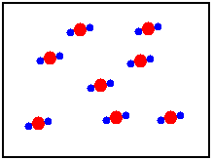
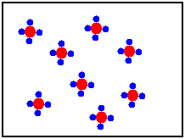
Compounds
Lead has two charges listed, +2 and +4. This is a sample of lead (II) chloride (PbCl₂). Two or more elements bonded in a whole-number ratio is a COMPOUND.
This compound is formed from the +4 version of lead. This is lead (IV) chloride (PbCl₄). Notice how both samples of lead compounds have consistent composition throughout? Compounds are homogeneous!
ہفتہ, 7, نومبر 2026

Slide 15
Types of Compounds
Ionic: made of metal and nonmetal ions. Form an ionic crystal lattice when in the solid phase. Ions separate when melted or dissolved in water, allowing electrical conduction. Examples: NaCl, K₂O, CaBr₂
Molecular: made of nonmetal atoms bonded to form a distinct particle called a molecule. Bonds do not break upon melting or dissolving, so molecular substances do not conduct electricity. EXCEPTION: Acids [H⁺A⁻ (aq)] ionize in water to form H₃O⁺ and A⁻, so they do conduct.
Network: made up of nonmetal atoms bonded in a seemingly endless matrix of covalent bonds with no distinguishable molecules. Very high m.p., don’t conduct.
ہفتہ, 7, نومبر 2026

Slide 16
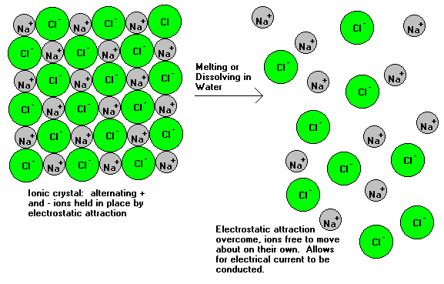
Ionic Compounds
ہفتہ, 7, نومبر 2026

Slide 17
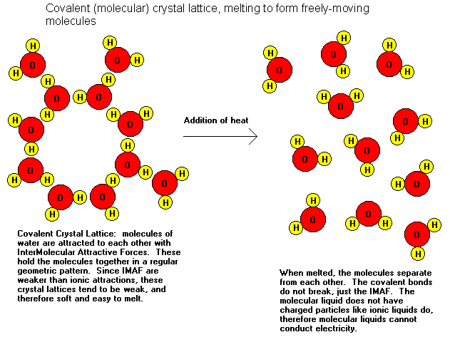
Molecular Compounds
ہفتہ, 7, نومبر 2026

Slide 18
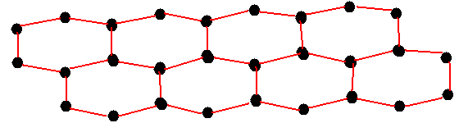
Network Solids
Network solids are made of nonmetal atoms covalently bonded together to form large crystal lattices. No individual molecules can be distinguished. Examples include SiO₂ (quartz). Corundum (Al₂O₃) also forms these, even though Al is considered a metal. Network solids are among the hardest materials known. They have extremely high melting points and do not conduct electricity.
ہفتہ, 7, نومبر 2026

Slide 19
EXAMPLES OF SOME FORMULA
S.No. | COMPOUND | FORMULA | ELEMENT | FORMULA
1 2 3 4 5 6 | Water Sodium hydroxide Calcium carbonate Ethanol Sulphuric acid Barium nitrate | H₂O NaOH CaCO₃ C₂H₅OH H₂SO₄ Ba(NO₃)₂ | Hydrogen Oxygen Chlorine Nitrogen Fluorine Bromine | H₂ O₂ Cl₂ N₂ F₂ Br₂
ہفتہ, 7, نومبر 2026

Slide 20
Mixtures
Heterogeneous mixtures are not uniform throughout.
Homogeneous mixtures are uniform throughout.
Homogeneous mixtures are called solutions.
ہفتہ, 7, نومبر 2026

Slide 21
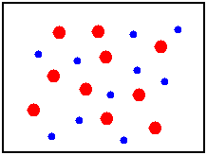
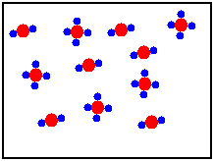
Mixtures
A mixture of lead atoms and chlorine atoms. They exist in no particular ratio and are not chemically combined with each other. They can be separated by physical means.
A mixture of PbCl₂ and PbCl₄ formula units. Again, they are in no particular ratio to each other and can be separated without chemical change.
ہفتہ, 7, نومبر 2026

Slide 22
CHARACTERISTICS OF MIXTURE
It is an impure substance
No formula
They can be mixed in any ratio.
The properties of the mixture are the properties of its constituents.
Constituents can be easily seperated by physical methods e.g. heating, drying, crystallization, distillation etc.
It is either homogenous or heterogenous.
ہفتہ, 7, نومبر 2026

Slide 23
DIFFERENCE BETWEEN COMPOUNDS & MIXTURES
S. No. | MIXTURE | COMPOUNDS
1 2 3 4 | The substance are mixed together, no reaction take place. Composition can be varied Properties of the constituents present, remain same. Can be separated by physical method such as filtration, distillation etc. | Substance chemically react to form a new compound. Composition of new compound is always same. The properties of new compound are very different from those of the element in it. Cannot easily be separated into its elements.
ہفتہ, 7, نومبر 2026

Slide 24
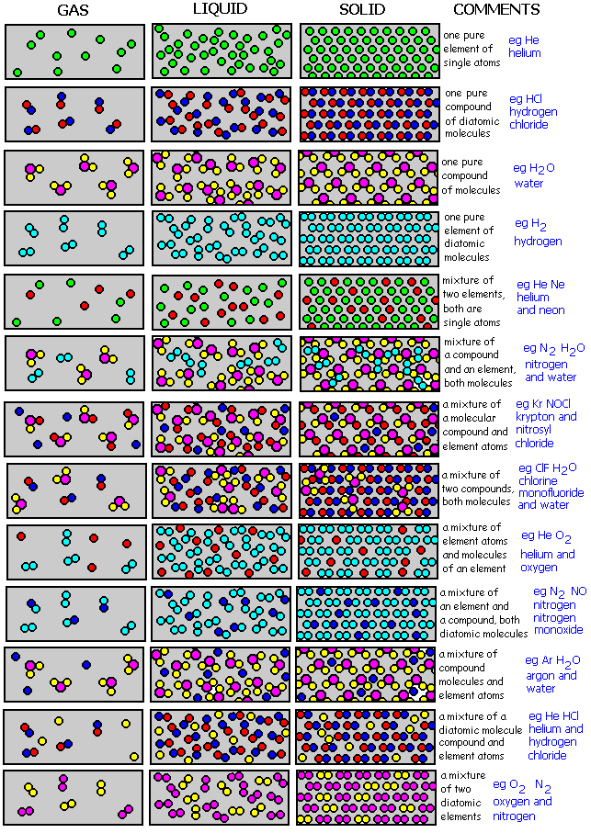
ہفتہ, 7, نومبر 2026

Slide 25
Physical vs. Chemical Properties
Physical properties can be measure without changing the basic identity of the substance (e.g., color, density, odor, melting point)
Chemical properties describe how substances react or change to form different substances (e.g., hydrogen burns in oxygen)
Intensive physical properties do not depend on how much of the substance is present.
  Examples: density, temperature, and melting point.
Extensive physical properties depend on the amount of substance present.
  Examples: mass, volume, pressure.
ہفتہ, 7, نومبر 2026

Slide 26
Physical and Chemical Changes
When a substance undergoes a physical change, its physical appearance changes.
  Ice melts: a solid is converted into a liquid.
Physical changes do not result in a change of composition.
When a substance changes its composition, it undergoes a chemical change:
  When pure hydrogen and pure oxygen react completely, they form pure water. In the flask containing water, there is no oxygen or hydrogen left over.
ہفتہ, 7, نومبر 2026

Slide 27
TESTING THE PURITY OF A SUBSTANCE
S.No | TEST | PURE SUBSTANCE | IMPURE SUBSTANCE
1 | MELTING POINT | It melts at a fix temperature e.g pure naphthalene melts at 80ºC | Do not have a fix melting point. It melts at a range of temperature. Impurity lower down the m.p. The greater the % of impurity the lower the m.p. e.g. impure naphthalene melts at 76ºC to 78ºC.
2 | BOILING POINT | It boils at fixed temperature e.g. pure ethanol boils at 78ºC | It boils at a range of temperature e.g. petrol boils at 35ºC to 75ºC.
3 | CHROMATOGRAPHY | Pure substance will form one spot | Impure substance will form several spots.
ہفتہ, 7, نومبر 2026
Topic 5.1 : ELEMENTS, COMPOUNDS & MIXTURES
Notes:
CHEMISTRY RESOURCE 9C
M.ALI. SCIL, 2011-2012

Slide 28
THE END
ہفتہ, 7, نومبر 2026
Notes:
CHEMISTRY RESOURCE 9C
M.ALI. SCIL, 2011-2012

